Slide 1


From Development to Implementation:
A Community’s Success with
Arts for Learning
Lessons Learned from the i3 A4L Partnership Project in Beaverton , OR
Notes:
Title Slide

Slide 2
Creating a Working Partnership
Notes:
Pete: Interest-based, mission-aware, capacity-wise, conditions-sensitive. Once the grant was visualized, how were partners brought together. Distinction between working partners and supporting partners, who were added after the grant was awarded and matching funds were required.

Slide 3

Partners
Beaverton School District
Young Audiences of Oregon
Young Audiences National
U of Washington
WestEd
Supporters
Beaverton Arts Foundation
Beaverton Education Foundation
City of Beaverton, Arts & Culture
Columbia Sportswear
Collins Foundation
Intel
Meyer Memorial Trust
Miller Foundation
Pacific Automation
Notes:
Pete (intro) Rebecca (process within district of identifying schools & teachers): In January of 2010, 16 elementary schools were identified to participate and an informational meeting was held. Principals identified one teacher in each school from grades 3-5 to be “lead teachers”….

Slide 4
Engaging the Partnership
Notes:
Pete with comments from Rebecca (getting teachers to feel ownership) & Jan (building on foundational relationships): Getting partners to become engaged at progressively deeper and broader levels. E.g. Beyond District adoption and mandate, how to engage the teachers, principals and other partners.

Slide 5




Excellence
Collaboration
Innovation
Equity
Notes:
Pete: A4L aligns with Beaverton’s 4 Pillars of Learning – Innovation (the arts are fundamental and integrated), Collaboration (with our partners, teachers in grade level teams, student performances), Excellence (aligned with CCSS), Equity (built in supports for ELLs)

Slide 6
Scope and Sequence of A4L in Beaverton
Grade Level Assignment | Unit & Title | Primary Literacy Concepts & Skills | Art Form, Specific Art Techniques & Elements | Text Genre & Literary Work(s) | Primary CCSS Addressed
3rd grade Fall Semester | Character Clues in Action | Character perspective, Character traits, Making inferences, Story elements | Theater: tableau, facial expression, vocal expression, gesture, body shapes, levels, playing space | Fiction/Fairytales: The Three Little Pigs; The True Story of the Three Little Pigs by John Scieszka; Toys Go Out by Emily Jenkins | Describe characters in a story (traits, motivations or feelings); Compare and contrast two or more characters respond in a story, drawing on specific details in the text.
3rd grade Spring Semester | Words in Motion + Artist-in-Residence | Word meaning, Speaking with expression, Free-verse poetry, Synonyms & antonyms | Dance/Choreography: shape, levels, place, shared space, mirroring, improvisation | Poetry/Free-verse: Ralph Fletcher, Mark Vinz, Georgia Heard, and more | Demonstrate understanding of word relationships and nuances in word meanings; Read poetry orally with accuracy and expression.
4th grade Fall Semester | Authors & Actors | Narrative writing (Strong leads and endings, Sensory details) | Theater: idea-generating and kinesthetically-driven activities | Personal Narratives: The Wall by Eve Bunting; Knucklehead by Jon Scieszka; Best Friends by Mary Beth Olsen | Write narratives to develop real experiences using effective technique, descriptive details, and clear event sequencing; Use sensory details to convey experiences.
4th grade Spring Semester | Everyday Heroes + Artist-in-Residence | Synthesizing, Determining importance, Drawing Evidence, Note-taking | Visual art/Collage: shape, size, line, color, space, emphasis, balance, symbol, texture/implied texture | Nonfiction/Biography & Informational Text: Roberto Clemente by Jonah Winter; Romare Bearden: Collage of Memories by Jan Greenberg; Reference Materials | Integrate information from two texts on the same topic in order to write or speak about the subject knowledgeably; draw evidence from text to support analysis, reflection and research.
5th grade Fall Semester | Graphic Story Adventures | Fiction writing (Sequels), Story elements, Visualization, Author’s choice | Visual art/Graphic Novels: drafting, sketching, line, thought and voice bubbles, embedded text, narrative text, text type | Fiction/Fantasy & Adventure: Newbery-winner My Father’s Dragon by Ruth Stiles Gannett; Meanwhile by Jules Feiffer | Use narrative techniques, such as dialogue and description to develop events or show the responses of characters to situations; Analyze how visual and multimedia elements contribute to the meaning or tone of a text (graphic novel).
5th grade Spring Semester | Planting a Community + Artist-in-Residence | Theme, Annotating text, Making inferences, Text-to-text connections | Music/Composition: tempo, rhythm, pitch, melody, motif, duration, dynamic, tone color | Fiction: Seedfolks by Paul Fleischman | Determine a theme of a story, including how characters respond to challenges; Include multimedia components (sound) in presentations to enhance the development of main ideas or themes.

Slide 7

Arts for Learning
Mission includes:
“[thinking] about what it is that we learn from the art-making and the art-thinking process that can inform us, and make us better able to learn in literacy and other subjects.”
make us better able to learn in other subjects.”
Notes:
Jan: Arts for Learning is an arts-integrated supplemental literacy program of flexible, teacher-led instructional units supplemented by teaching artist residencies or experiences. The strategy of Arts for Learning is to combine the creativity and discipline of the arts with learning science to improve students’ achievement in reading and writing as well as learning and life skills.

Slide 8
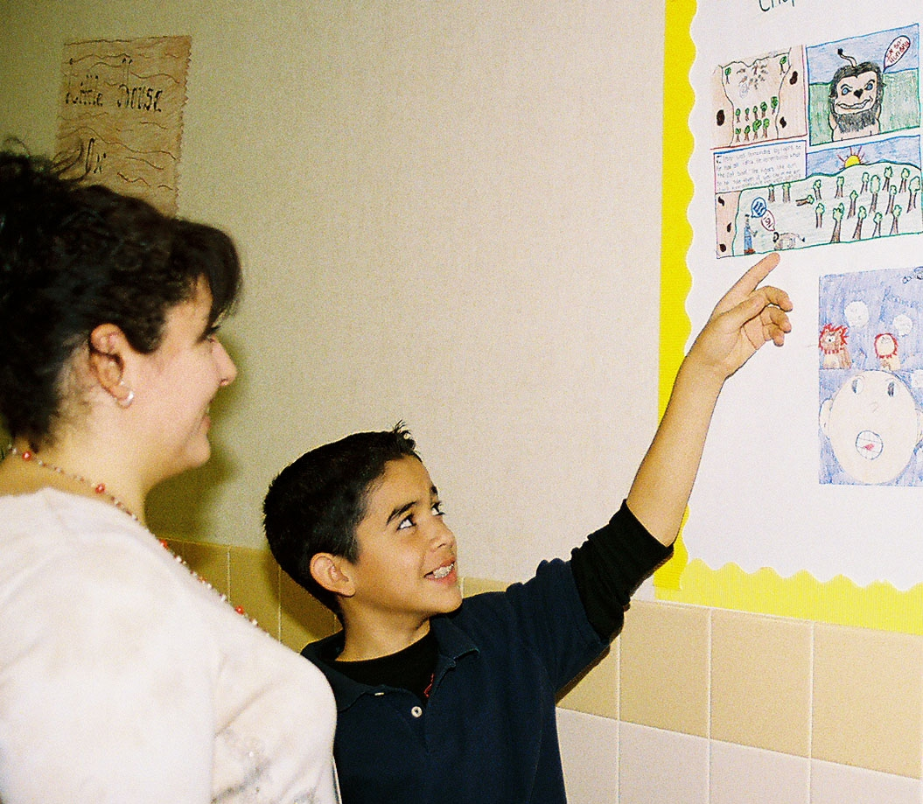
A4L supports the “4 C’s” in 21st Century Skills …
Creativity,
Collaboration,
Critical Thinking,
Communication.
Notes:
Jan: with current focus on school to college and career readiness, partnerships are integral to helping students become creative problem solvers and independent learners, equipped to be collaborative citizens of a community, critical thinkers, effective communicators in multiple ways, and innovative designers of a creative economy.

Slide 9
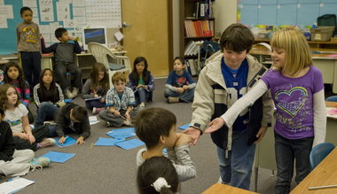
A4L Units also promote learning and life skills, such as curiosity, cooperation, and confidence…
Notes:
Jan and Rebecca: Creative thinking and learning is developed through arts integrated experiences in the classroom. Learning to learn is integral to Arts for Learning.

Slide 10
A4L Essential Components
Instructional Sequence within each Unit
Introduction to the Unit: Intention
Part 1: Learning – Defining Teacher-Led Instruction, Scaffolding, and Guided Practice
Part 2: Exploring – Exploring how to build on Guided Practice and Scaffolding through Independent Practice of Creating, Reflecting, Revising
Part 3: Sharing – Assessing learning by
Performing and Informing
10
Notes:
10
Jan & Rebecca: A4L units all begin with the “Intention,” followed by three-parts: Defining Learning, Exploring, & Sharing/Assessing. The word IDEA is an acronym that helps students remember the process.

Slide 11
Working with a Team Over Time
Notes:
Rebecca – Jan & Pete: How A4L was implemented and improved over time

Slide 12
Growth of i3 A4L Program in Beaverton over 5 Years
Notes:
Pete: Comparison of the growth over five years

Slide 13
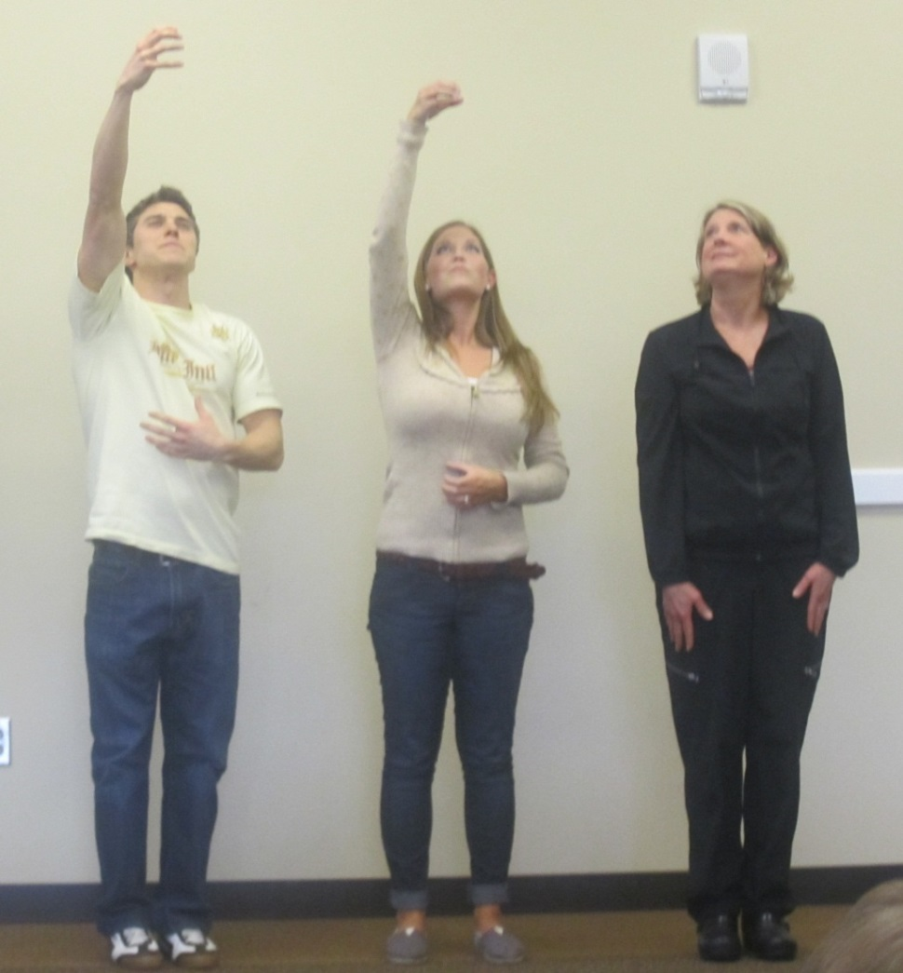
Pilot Year 2010-2011
16 Schools, 1 teacher from grades 3-5
Total Teacher Training: 48
Notes:
Rebecca: elaborate on the scale and participants each progressive year.

Slide 14
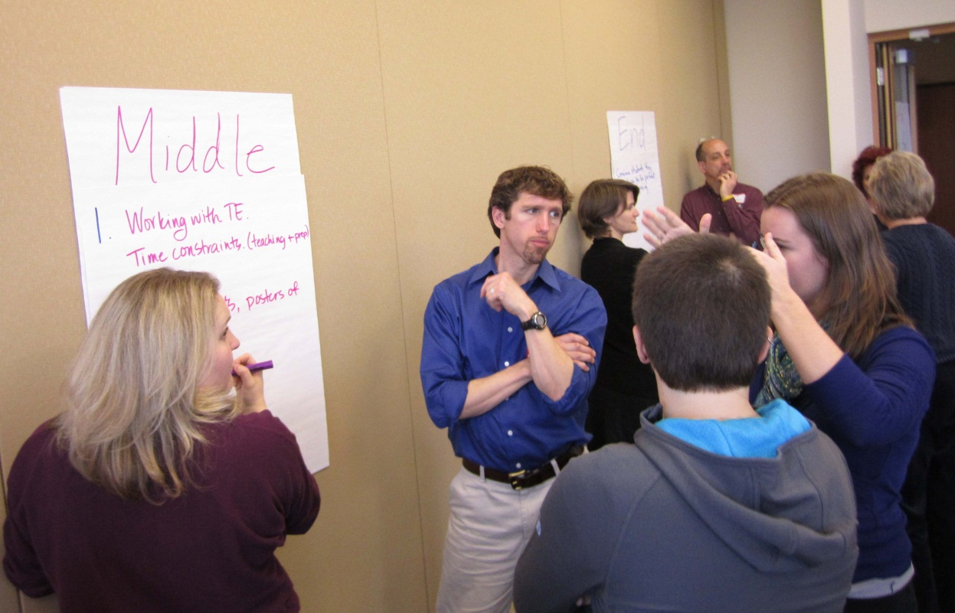
Years Two, Three & Four 2011-2014
Schools: 16 (all teachers in grades 3-5)
Total Teachers: 168
Notes:
Rebecca: Difficulties and benefits of expansion

Slide 15
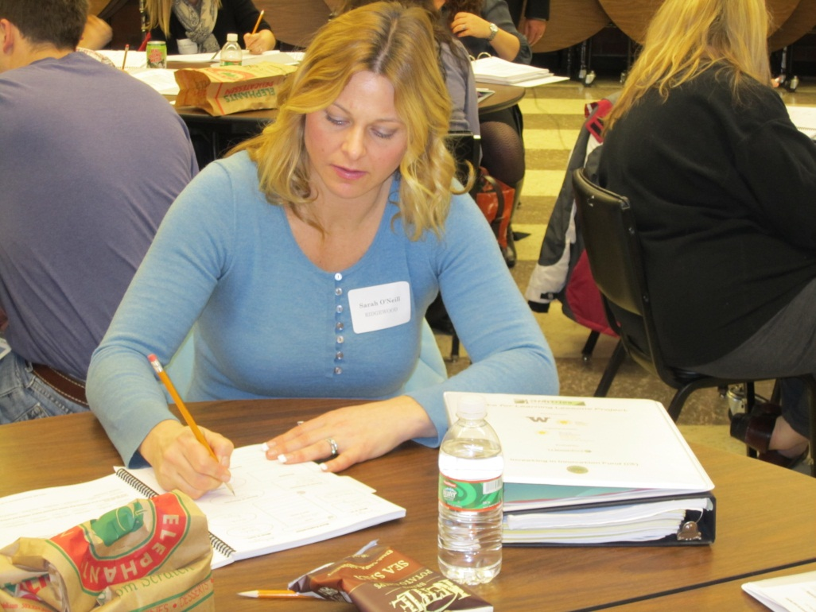
Year Five 2014-2015
Schools: 33
Total teachers: ~350
Notes:
Rebecca: challenges and benefits of district-wide adoption

Slide 16
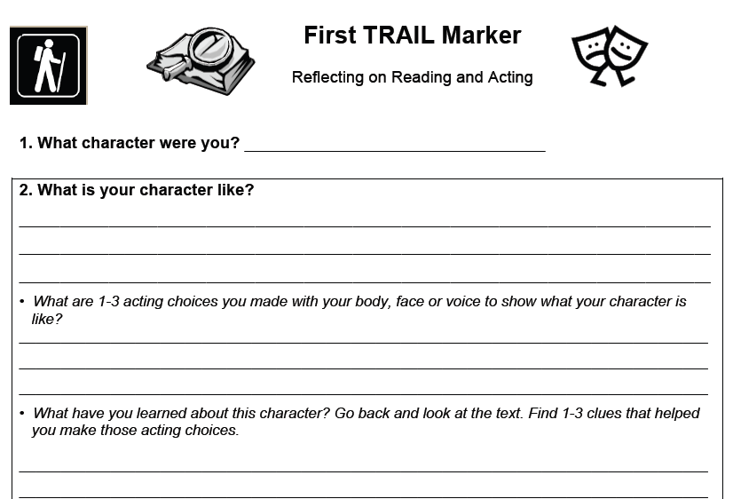
Notes:
Rebecca: U1 Student Notebook page. Note: Unit is primarily focused on character traits and perspectives.

Slide 17
Excellence
Collaboration
Innovation
Equity
Notes:
Pete: A4L aligns with Beaverton’s 4 Pillars of Learning – Innovation (the arts are fundamental and integrated), Collaboration (with our partners, teachers in grade level teams, student performances), Excellence (aligned with CCSS), Equity (built in supports for ELLs)

Slide 18
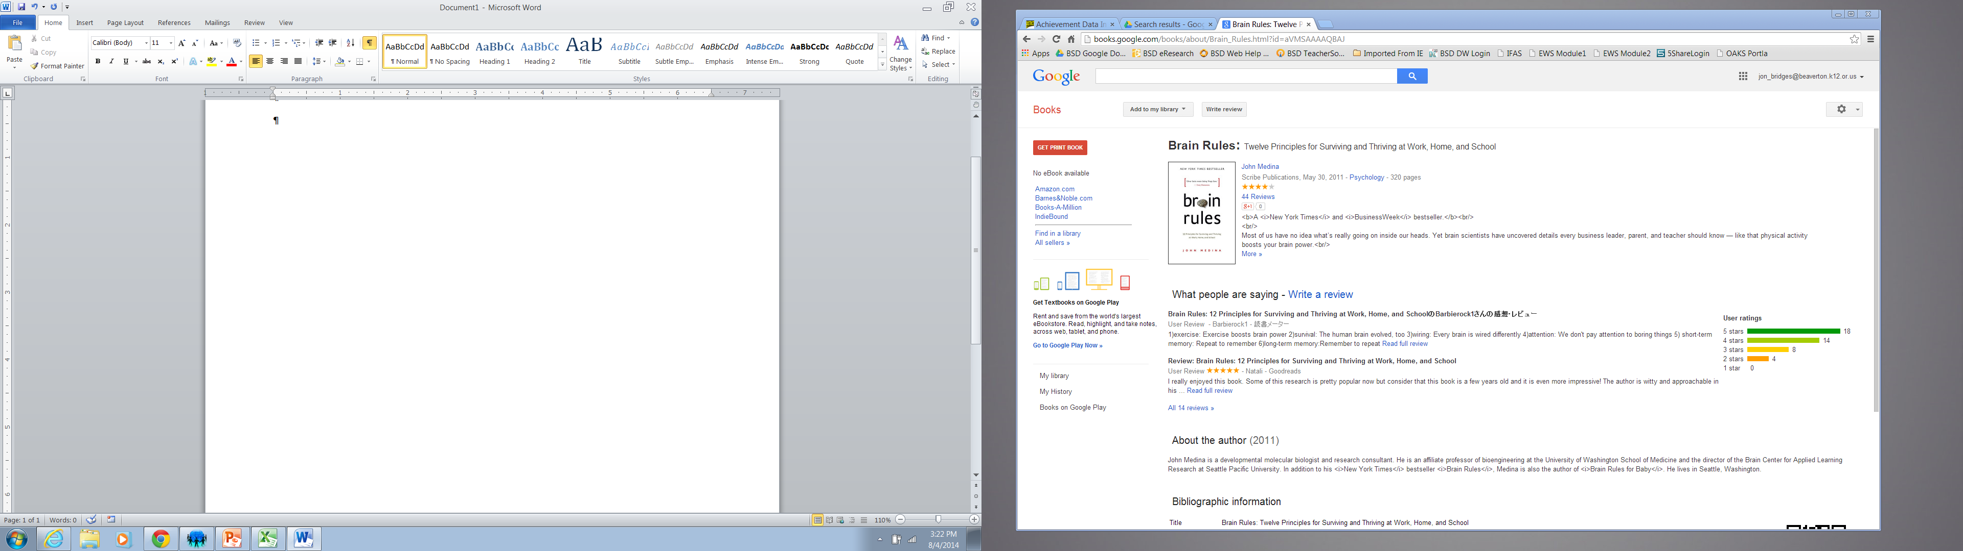
A4L Reflects Brain Rules
by John Medina
Survival
Exercise
Sleep
Stress
Wiring
Attention
Memory
Sensory Integration
Vision
Music
Gender
Exploration
Notes:
#1 Survival – Symbolic reasoning is a uniquely human talent. How Brain Rules are a resource to align with district goals, supported by A4L
A4L helps students synthesize knowledge and apply symbolic meaning through an art form
#6 Attention – People don’t pay attention to boring things
We are better at seeing patterns and abstracting the meaning of an event than recording detail.
Emotional arousal helps the brain learn!
Audiences check out after 10 minutes, but you can keep grabbing them back by telling narratives or creating events rich in emotion.
A4L is proven to engage students in learning and to help them understand, create and communicate meaning through the arts
#8 Sensory Integration – Stimulate more of the senses at the same time.
We absorb information, disperse those signals to separate parts of the brain, then reconstruct what happened to perceive, understand and remember the event as a whole.
A4L uses art experiences that include all the senses working together for effective learning.
#9 Vision – Vision trumps all other senses.
Vision is by far our most dominant sense, taking up half our brain’s resources.
We learn and remember best through pictures, not through written or spoken words.
A4L provides art experiences as visual learning and creative problem solving, and helps readers envision meaning from words.
#12 Exploration – We are powerful and natural explorers.
Babies model how we learn – not by passive reaction to the environment but by active testing through observation, hypothesis, experiment and conclusion.
A4L uses the principals of “How People Learn” and the “IDEA model” in which students…
Identify what they intend to do;
Define what they know and need to know;
Explore and experiment by creating, reflecting, revising;
Assessing by presenting/performing and informing others about their decisions and what they have learned

Slide 19

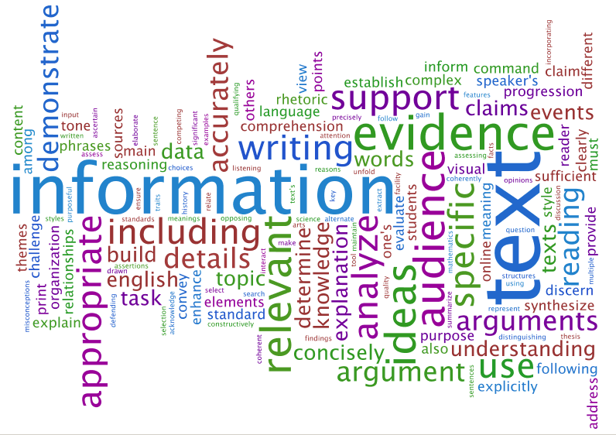
Common Core Alignment
Notes:
Rebecca then Jan: Units support and align with Common Core. Scope of Units doc + CCSS – Highlight ELA Speaking & Listening! (collaborative discussions, Perform & Inform, etc.)

Slide 20
“We are kicking off the year with our A4L Unit because it will build teamwork & trust!”
- 3rd grade teacher at Chehalem
“My students were better readers and writers this year because of A4L.”
-4th grade teacher at William Walker
“There was a tremendous gain in critical thinking. They went to a deeper level than they normally get to do during our literacy time.”
- 5th grade teacher at McKinley
Notes:
Rebecca: Quotes from teachers

Slide 21
Ways that A4L Research Was Collected
Pre/Post Cross Curriculum Unit Assessments (CCU’s)
Developed and field-tested over time with University of Washington and YA A4L network
Observations in the Classroom
Teacher Surveys
Documentation by video, audio and interviews
Focus Groups
Embedded Assessments
TRAIL Markers
Assessment Tool Kit
Standardized Tests
Reading, Writing, Math
Notes:
Jan then Rebecca: Formative Assessment instruments and strategies used with Summative Assessment in final two years.

Slide 22
Fall 2005 – Spring 2006
Fall 2006 – Spring 2007
Fall 2007 – Spring 2008
Fall 2008 – Spring 2009
Fall 2009 – Spring 2010
Fall 2010 – Spring 2011
Fall 2011 – Spring 2012
Fall 2012 – Spring 2013
Fall 2013 – Spring 2014
Fall 2013 – Spring 2014
Fall 2014 – Spring 2015 in progress
* Conducted by WestEd & University of Washington with coordination from National Young Audiences and YA Affiliate
Sites and Partnering Universities and School Districts
Arts for Learning was developed through research
*Research Studies & Reports
22
Notes:
22
Jan: Scale of the Research to refine and improve A4L and establish a pattern of effectiveness. Since the first year of designing and field-testing A4L Lessons in 2005 – 2006, continuous scientific research and assessment have been conducted through WestEd, an independent evaluation firm, the University of Washington, and Young Audiences in collaboration with research coordinators from other colleges, universities, and school districts.

Slide 23
Research Results
2006 – 2014 School Years
Arts for Learning Works
  A4L improves student literacy learning, across grades and reading levels (with recent studies showing improvement in math).
  National studies conducted by WestEd for 8 consecutive years showed a reliable pattern of statistically significant gains in literacy learning
Effectiveness of A4L increased with greater “Strength of Treatment”
  Supporting a Unit with an artist-led experience, or receiving more Units, contributes to greater gains
Students Reading Below Grade Level made statistically significant
literacy gains, including Title 1 & English Language Learners
A4L teaches 21st Century Learning and Life Skills
Students Showed Engagement & Interest in A4L Units
Students liked A4L more than regular reading lessons, said it was
easier, while making significantly greater gains in literacy
Notes:
Jan: Key findings with a Pattern of Effectiveness that increases validity of the results.

Slide 24
Sustaining Good Work Beyond the Initial Commitment
Notes:
Pete – Rebecca & Jan: Comments on sustainability, scalability, replication. Other projects, grants and implementation, e.g. JCP and PDAE

Slide 25
What is your story?
Questions???
Discussion
Notes:
Open discussion and Q&A

Slide 26
Brad Lechtenberg

