Slide 1




Harnessing the Power
of
STEM and the Arts
Using Community Connections to Lead Change
2:00-3:15pm, April 23, 2015
Arts Partners Wichita
Lisa Muci, Program Director
Aaron Fowler, Teaching Artist
Aimee Geist, Executive Director
Notes:
Good afternoon!
Thank you to teaching artist Aaron Fowler from Arts Partners Wichita.
STEM and Leading Change through Community Connections

Slide 2


Learn how Arts Partners experienced a 300%
increase in the development of STEM-based
programs in the last two years. By collaborating with STEM and educational professionals, Arts Partners created numerous workshops, guiding teachers and teaching artists to gain confidence integrating the arts with STEM subjects.
Notes:
STEM Learning through the Arts Research. Donor, Katie.
Julia McBride spoke about challenges to leadership.
Share at your table or the person next to you, etc. a specific experience when you wanted to make/lead change – it needn’t be related to STEM – but it wasn’t successful.
And then, in a couple of minutes, let’s share our recollections with the group.

Slide 3
Top Three Steps to Lead Change
  Find your niche
  Identify your stakeholders
  Inspire and mobilize your stakeholders …to be influential stakeholders
Notes:
At Arts Partners, we found there to be 3 steps imperative to leading the change we wanted to see.
At Arts Partners Wichita, we knew that the change we wanted to lead was around using the arts to teach STEM subjects.
We thought we knew who our stakeholders were!
3. You cannot engage your stakeholders until you know who they are...and until they know who they are!

Slide 4

  Find Your Niche
According to a June 2013 study by the
Brookings Institute, Wichita ranked 22nd
among the 100 largest metro areas in the United States for STEM jobs.
Notes:
How did we know our niche? Education, economy. Wichita is #50 in the list of largest US metropolitan areas, but #22 of those cities for concentration of STEM jobs. Wichita is known as the air capital of the world. If you flew into Kansas City for the conference – or if you fly anywhere in the world – chances are that the plane you were on had some connection to Wichita…be it design, manufacturing, the translation of tech manuals, etc. There is also an United States Air Force Base located there. We knew STEM was our niche, and we already had a few programs in play.

Slide 5
  Identify Your Stakeholders
Board of Directors
School District
Donors
STEM Business Community
Higher Education
Teachers
Teaching Artists
Parents
Students
Notes:
What makes a stakeholder a stakeholder? Those who have invested: personally, with time, with money. Those who will benefit: those who have invested, those who don’t know yet
Who is missing? Those who don’t necessarily have “leadership” titles, but, who, nonetheless are leaders. Leadership being an activity, rather than a title or position, as discussed in the morning keynote.

Slide 6
  Inspire and Mobilize
  Your Stakeholders to be Influential Stakeholders
Write compelling grant applications.
Present convincing professional development sessions.
Communicate with intention. Reiterate.
Shape the vision. Timeline.
Prove it!
Notes:
Get your stakeholders to buy into what you are selling…in this case, STEM Learning through the Arts.
Write grants. If you can get just one…you can get another!
Present convincing professional development sessions for teachers and teaching artists
Communicate with intention. Reiterate
Shape the vision. What does it look like. Timeline.
Prove it!

Slide 7
  Research
Will arts-integrated residencies and workshops increase engagement in and interest in STEM subjects for students from preschool through 5th grade?
How will teacher attitudes, beliefs and knowledge of STEM Learning through the Arts strategies change as a result of Arts Partners programs?
Notes:
STEM Learning through the Arts Research Inquiry Questions

Slide 8
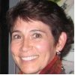



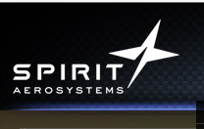

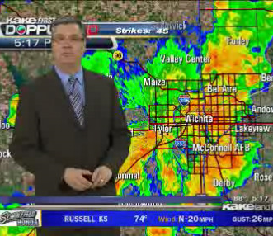
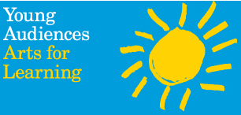
  Stakeholders
School District – Dr. Lisa Lutz
Executive Director of Innovation and Evaluation, USD #259
Higher Education – Dr. Kimberly McDowell
Research Fellow/Education Professor
Center for Research and Evaluation Services, WSU
STEM Community
Notes:
Some of the numerous stakeholders.

Slide 9
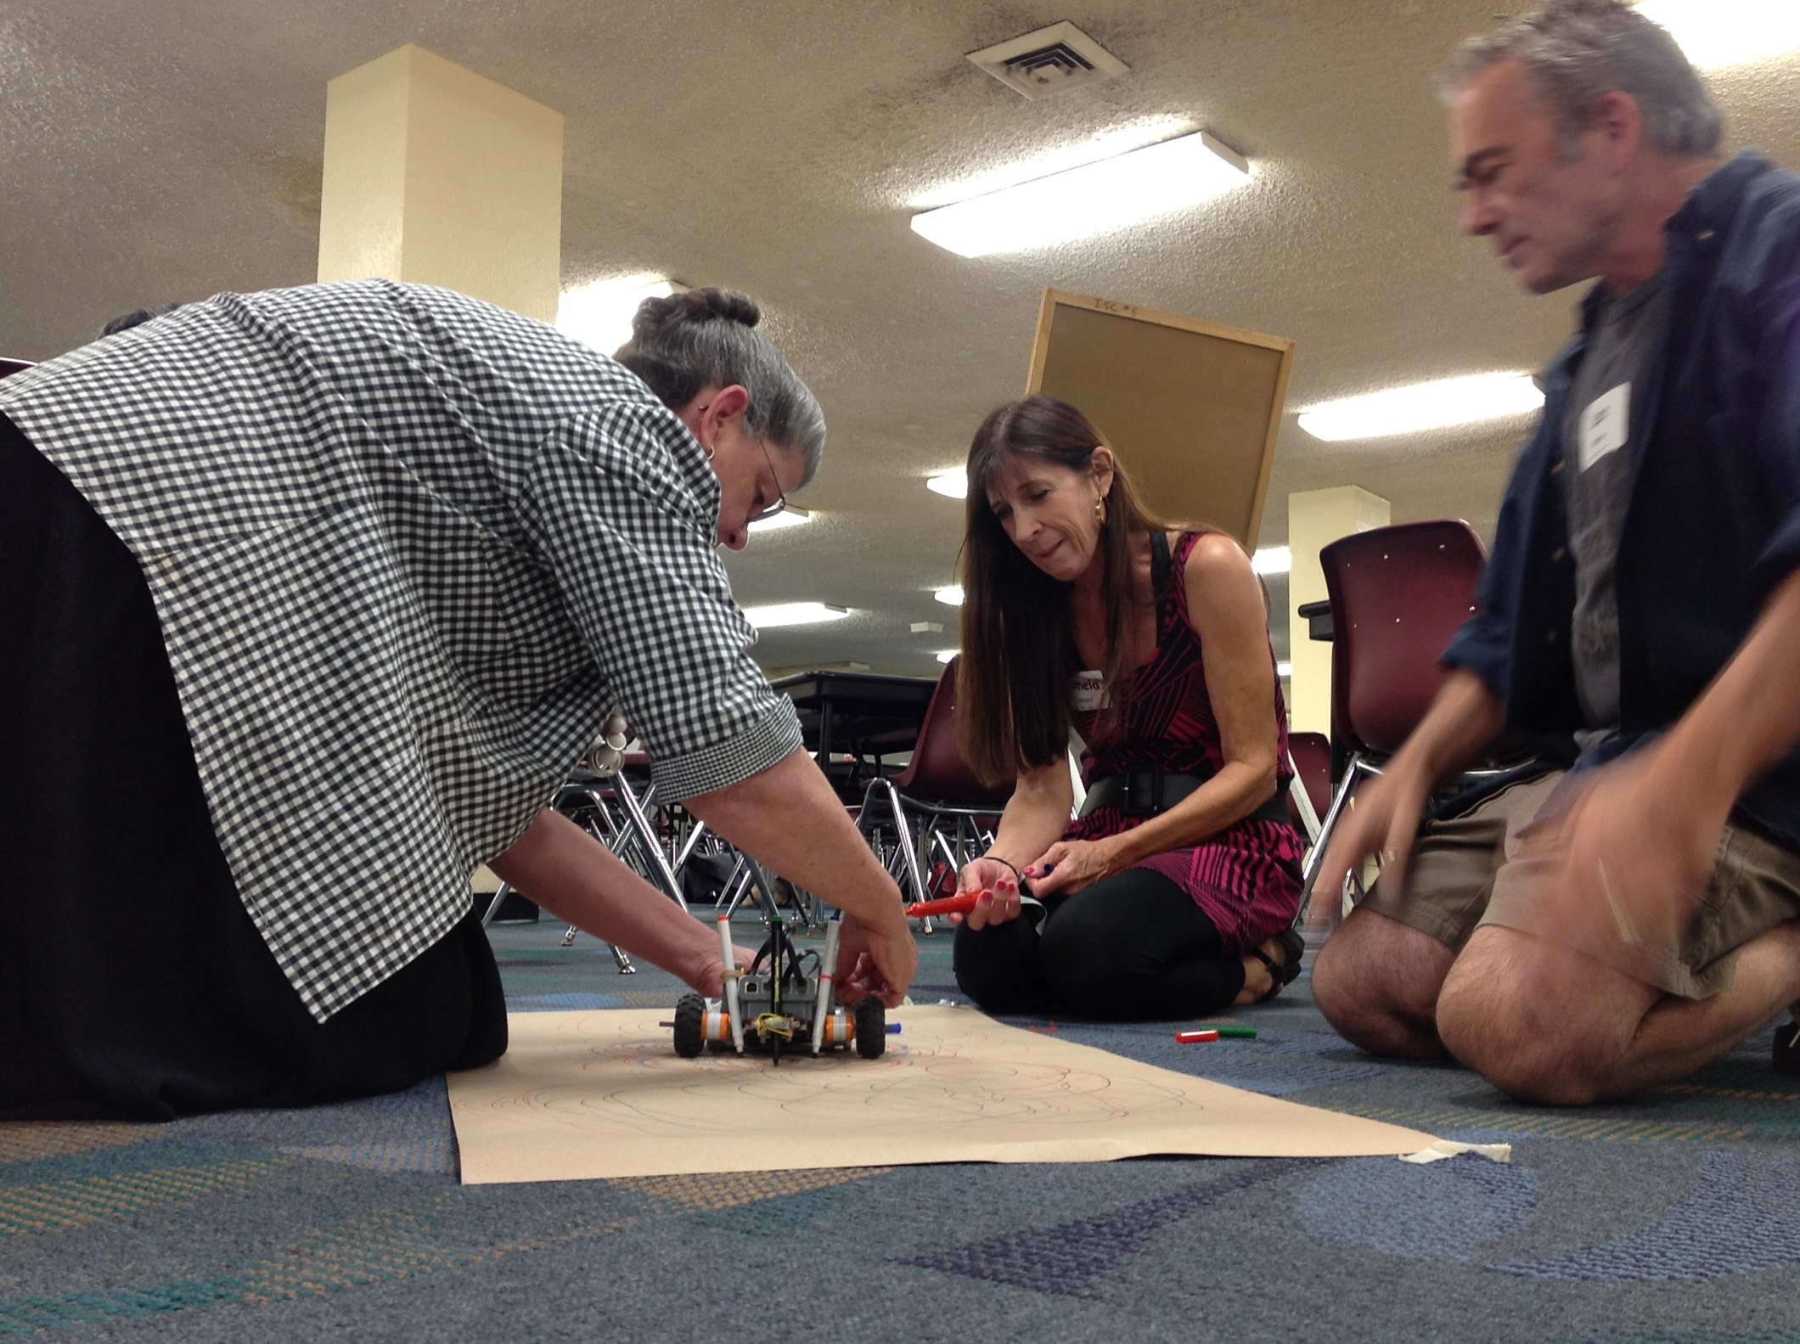
Notes:
Stakeholders! Teaching Artists! Were provided with experiences in STEM fields led by STEM professionals.

Slide 10
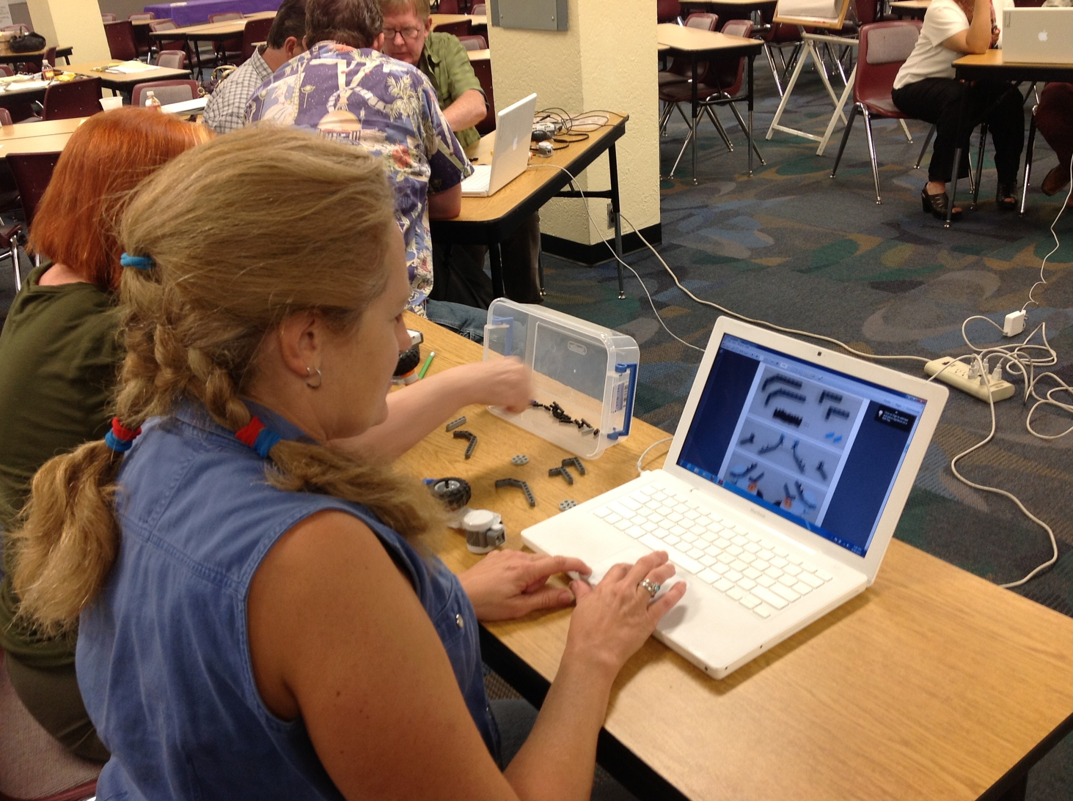
Notes:
Stakeholders! Teaching Artists! Were provided with experiences in STEM fields led by STEM professionals.

Slide 11
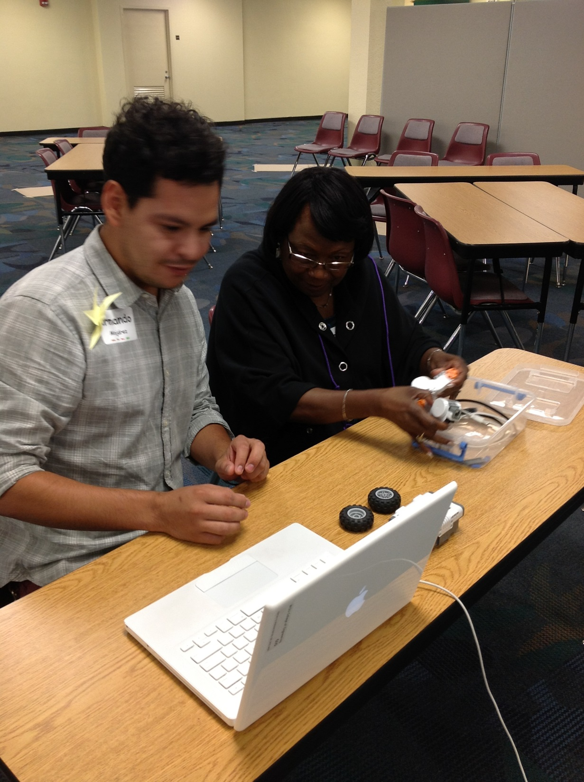
Notes:
Stakeholders! Teaching Artists! Were provided with experiences in STEM fields led by STEM professionals.

Slide 12
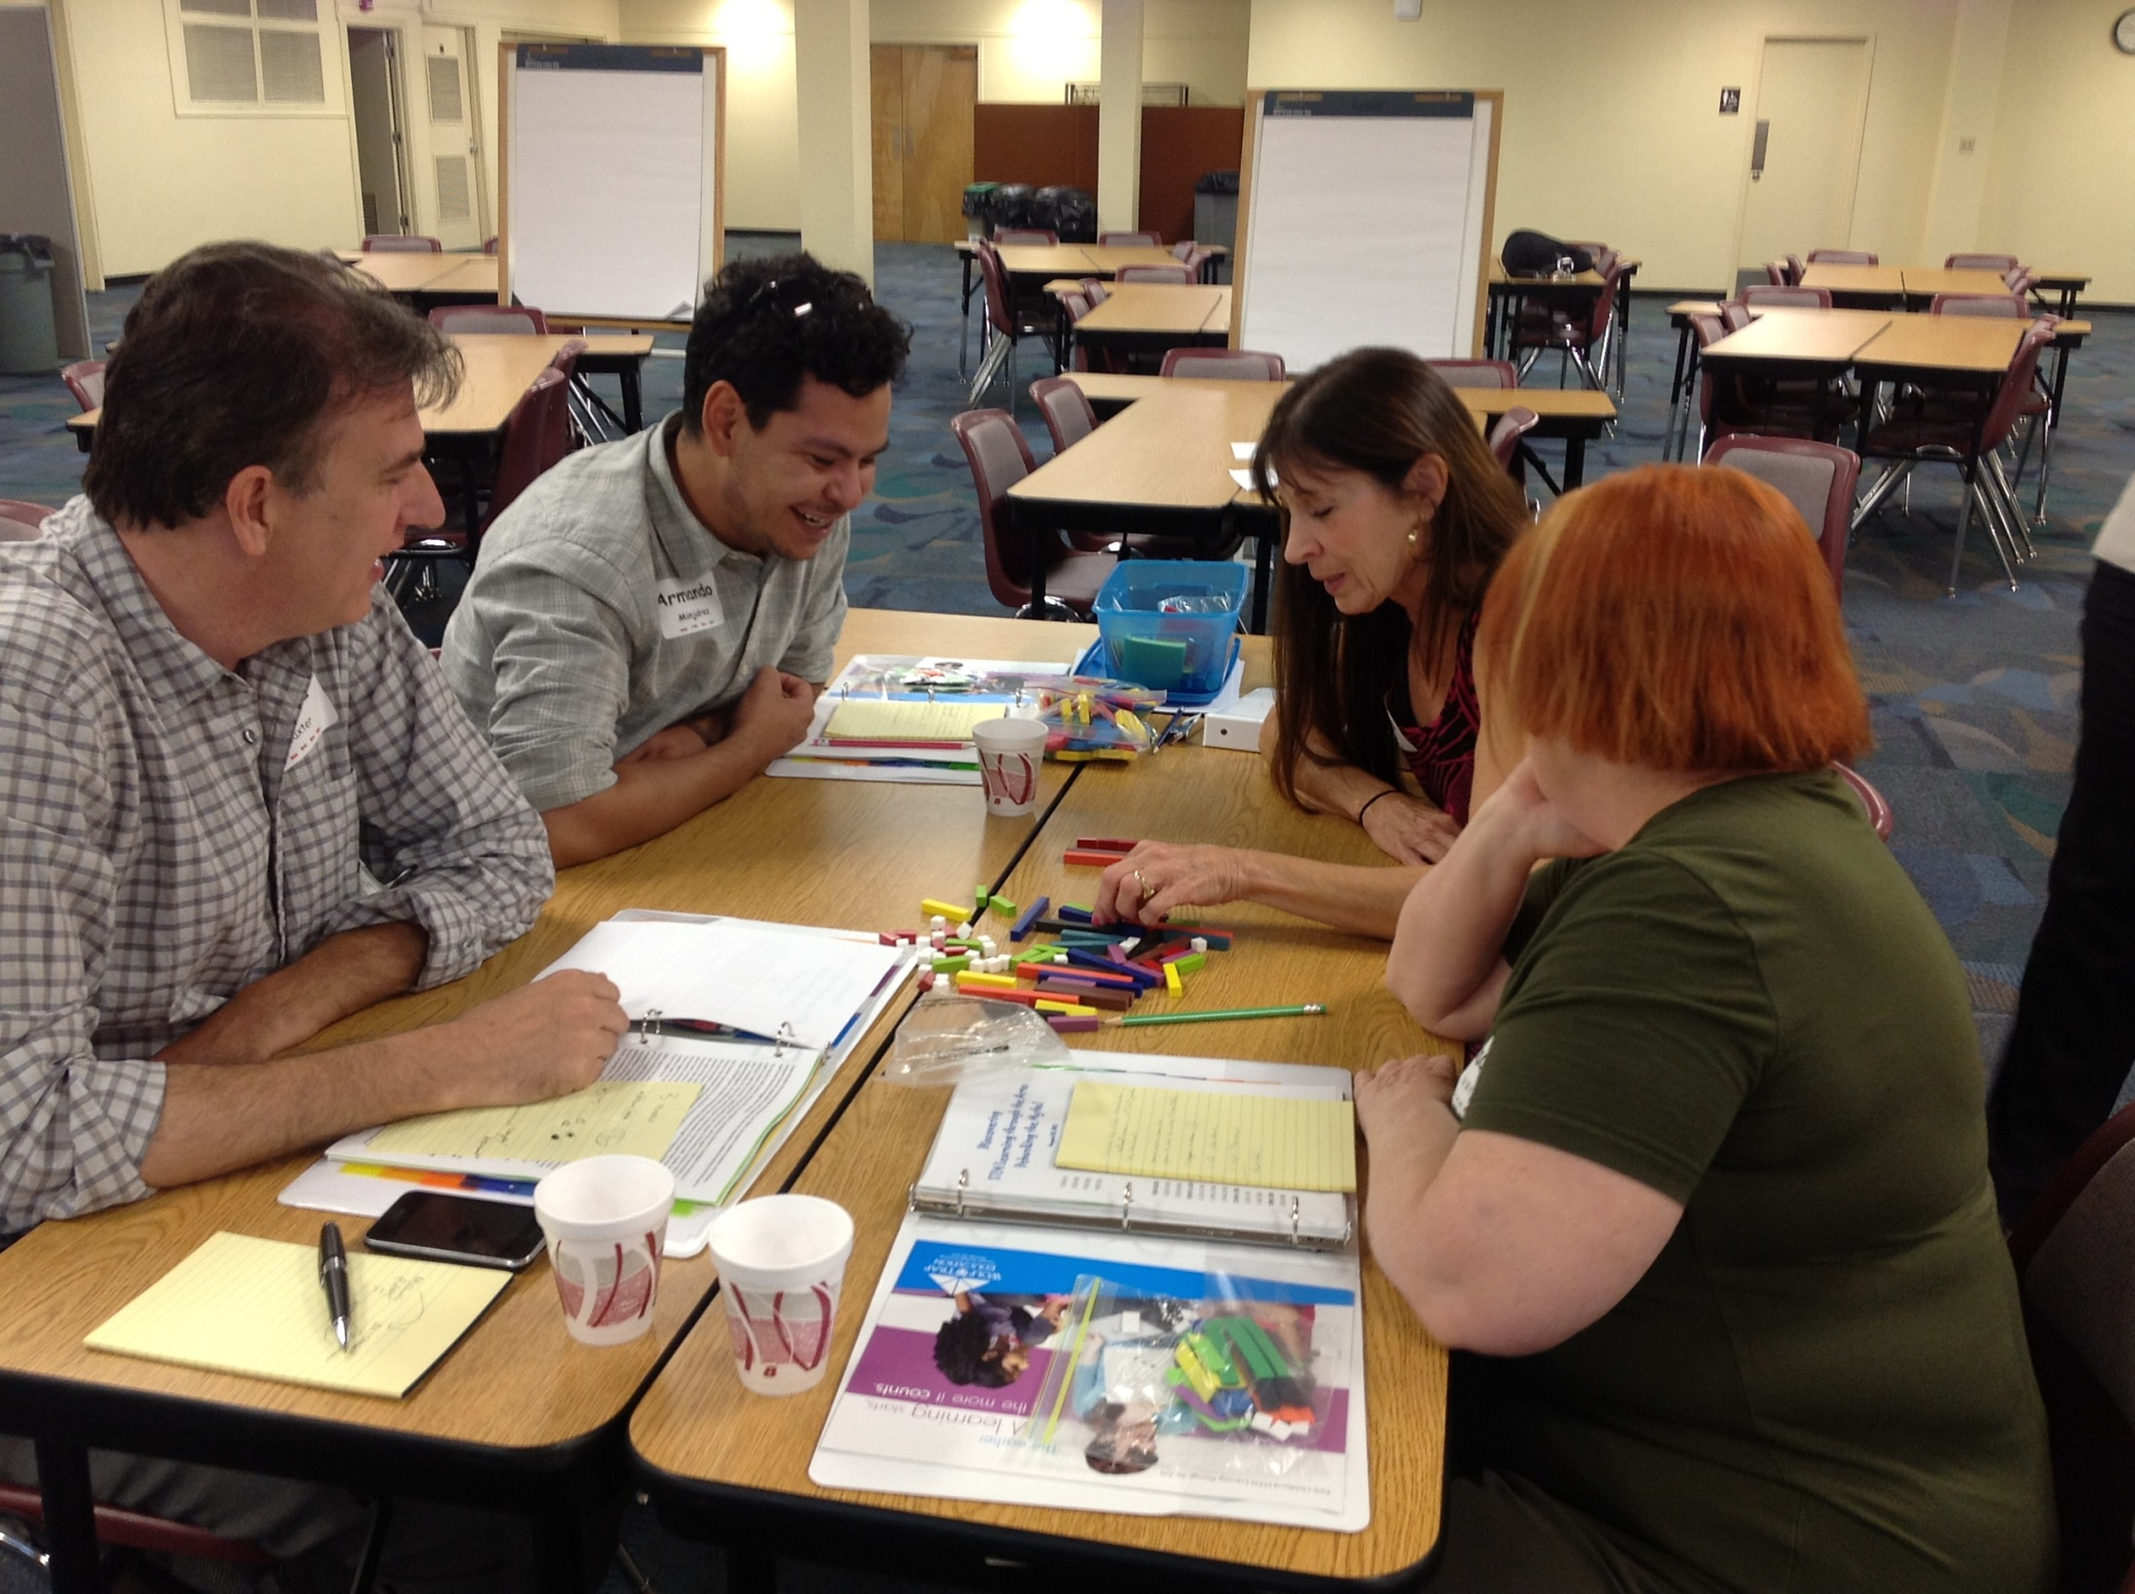
Notes:
Stakeholders! Teaching Artists! Were provided with experiences in STEM fields led by STEM professionals.
Cuisenaire Rods

Slide 13
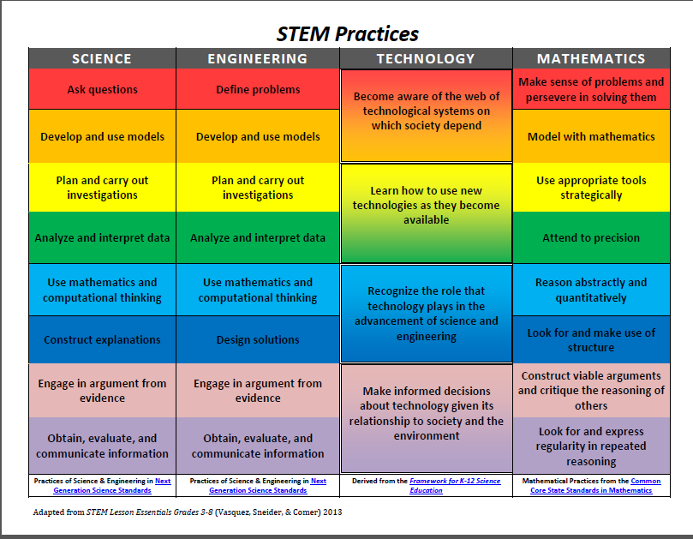
Notes:
STEM Practices.
Ongoing support for teaching artists…music, theater/drama, visual art, literary arts.

Slide 14
“But it’s better!”
Notes:
Play The 3-Legged Stool Video
Program outlines
https://www.youtube.com/watch?list=UUc9ginrL04UsxJSyJlxtFiQ&v=2fX7MZoOVaA

Slide 15
Top Three Steps to Lead Change
  Find your niche
  Identify your stakeholders
  Inspire and mobilize your stakeholders …to be influential stakeholders
Notes:
What will you do?

Slide 16
  Inspire and Mobilize
  Your Stakeholders to be Influential Stakeholders
Write compelling grant applications.
Present convincing professional development sessions.
Communicate with intention. Reiterate.
Shape the vision. Timeline.
Prove it!

Slide 17
Q & A
Notes:
Program examples, etc.

Slide 18
Harnessing the Power
of
STEM and the Arts
Using Community Connections to Lead Change
Arts Partners Wichita
Lisa Muci, Program Director
lisa@artspartnerswichita.org
Aaron Fowler, Teaching Artist/Artist Coordinator
aaron@artspartnerswichita.org
Aimee Geist, Executive Director
Notes:
Thank you.

